Slide 1


Measuring Emissions and Standardising the Reporting Structure
Notes:
Global warming is one of the biggest problems that the Globe is facing. It have significant implications: (Brüggemann & Rödder 2020)
direct physical risks that impacts agriculture destruction, animal extinction, natural disasters, human wellbeing
financial impacts that affect asset damage, transition from energy source risk, supply chain disruption, volatile markets.

Slide 2















Problem Statement
Establishing International Standards
Unified ESG Guidelines
Regulatory Collaboration
Data Collection Protocols
Transparency and Verification
Notes:
Also on a micro level, the company may need to report to multiple bodies

Slide 3


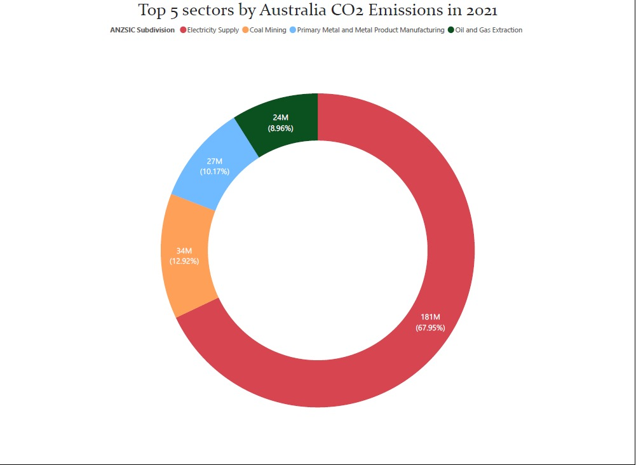
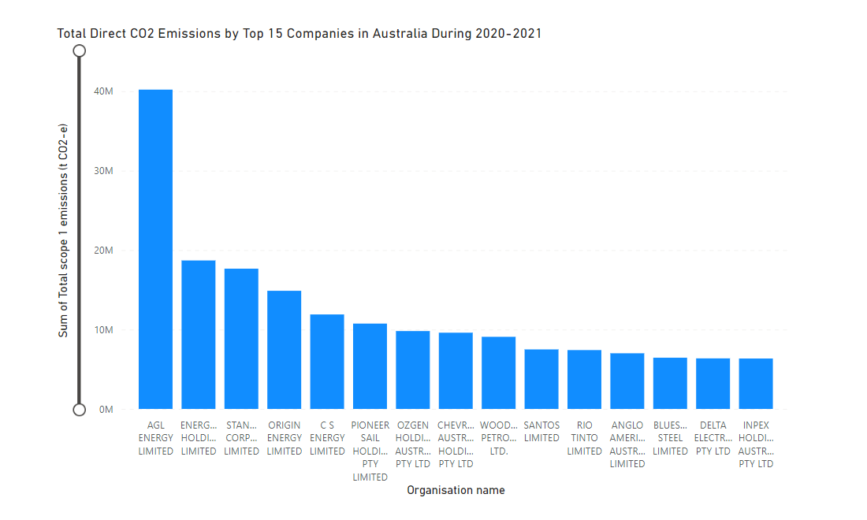
Micro Approach
Top Industries with Carbon Footprint
Main Contributing Variables
Define Data Capturing Tech
Notes:
Largest Carbon Emitters in Australia from industry perspective
Start identifying the main variables in each industry that contributes to carbon emission using open source data and data mining
Define and understand the data capturing methods that are available for the industries
Creation of intensive schemes for companies in the targeted industries to purchase the identified data capturing technology

Slide 4



Proposed Solution
Governmental Bodies
Companies
Energy Advisor/Auditor

Slide 5
Proposed Solution
Identify variables in every operating company in all industries
Be a data hub where all energy consumption data is collected & stored
Create a platform for both Companies & Government Bodies
Perform audit and advisory actions for companies to assure compliance

Slide 6

Proposed Solution

Slide 7



Why Is It Better
Inclusive Scope
Compliance Assurance
Company Specific Capturing Points
Cost & Time Efficiency
Physical & Financial Impacts are Gathered
Data Reliability
Incentivise Rewards Such as Tax-Cuts
All Stake Holders are Up-to-Date
Notes:
Inclusive Scope where all industries are considered and all companies are considered

Slide 8

Conclusion
Macro & Micro Level Variables Identified
Unified Data Metrics
More Accurate Situational Analysis
Practical Emissions Goal Setting
Practical Data-Driven Incentives & Rewards Generated

